Slide 1
Dream or Reality?
CICD For Fintech
by: Umair Khalid & Ali Jaffer
Notes:
Hello Everyone. My name is Umair Khalid. I’m Head of DevOps in TPS Worldwide and Chapter Head of Pakistan Agile Development Society.
Alongside me is Ali Jaffer.
I’m Senior DevOps Manager at TPS and an Executive Team member of Pakistan Agile Development Society.
Today, we’re going to discuss how practical it is to implement and adopt CICD in a Fintech organization.

Slide 2
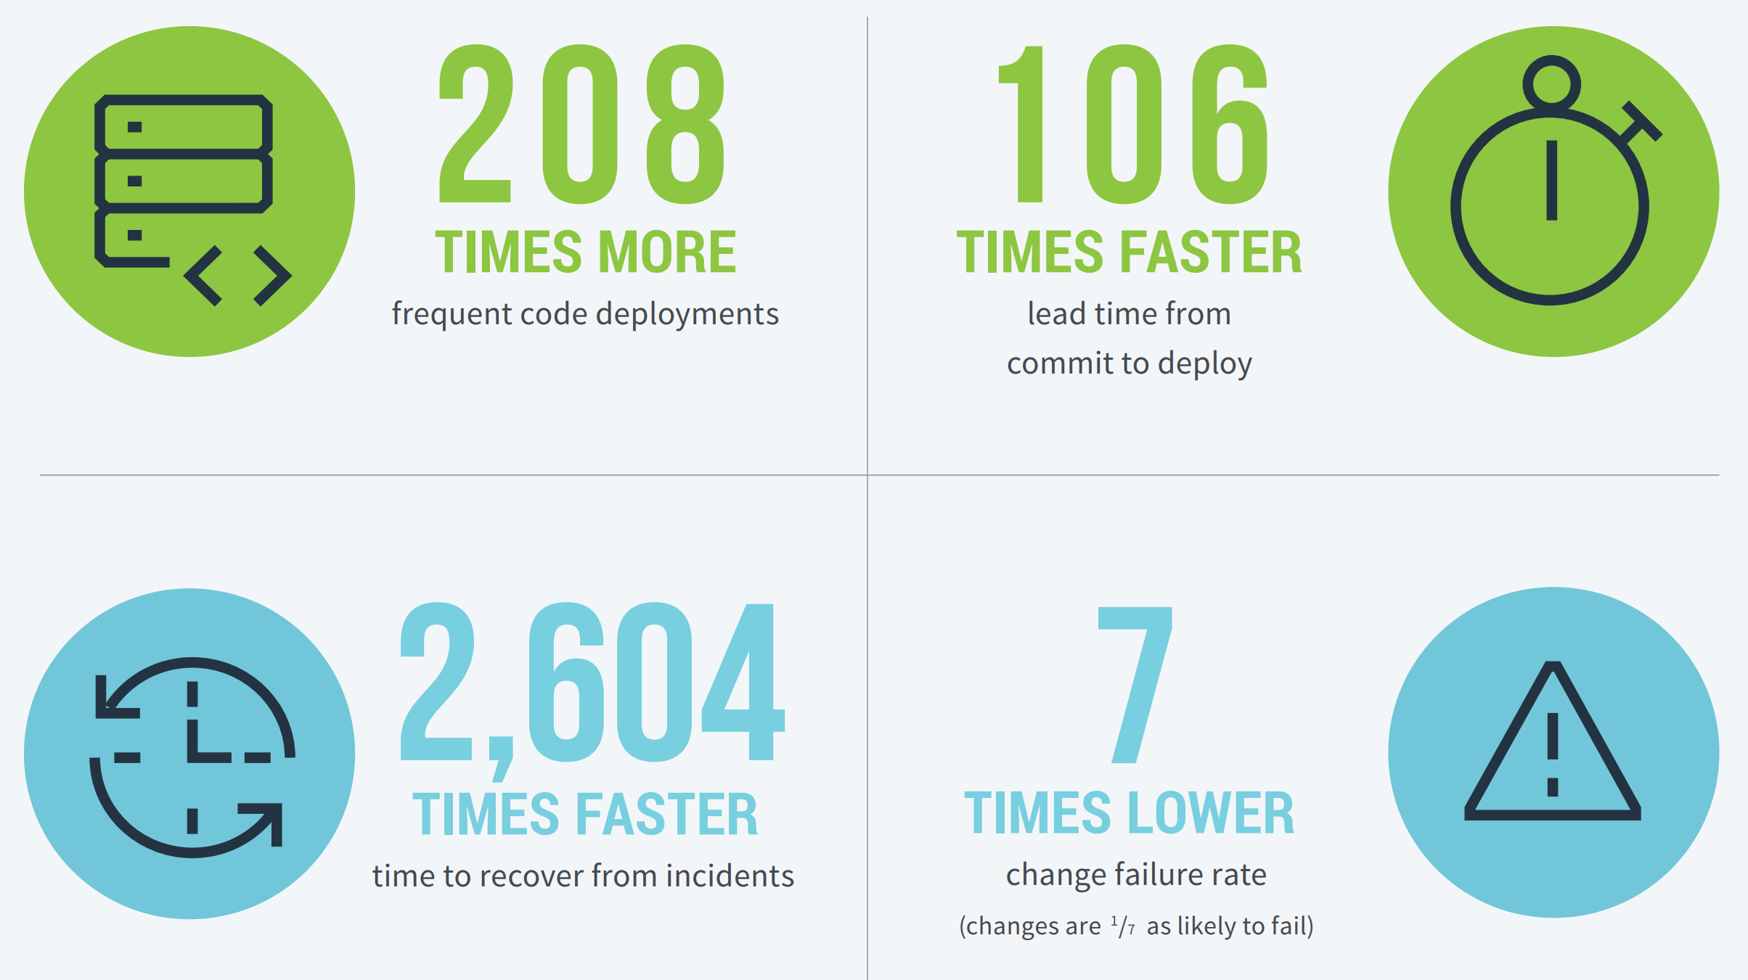
Why Any Organization Needs CICD?
Top Performers vs Low Performers
Notes:
Looking at the DevOps Report 2018, it shows that CICD has been a differentiating factor between top performers and the low performers. It enables more frequent code deployments, faster lead time, faster time to recover and lower failure rate. Obviously, there are certain other benefits of having CICD but we have picked that are most relevant for a Fintech organization.

Slide 3
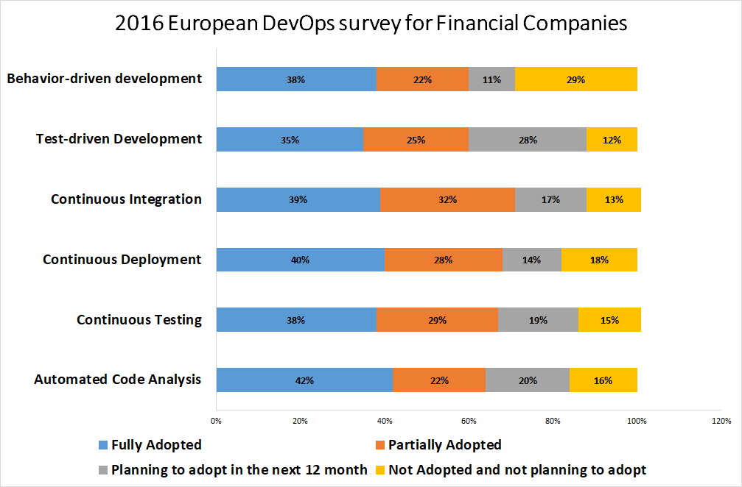
2016 European DevOps Survey for Financial Companies
Notes:
That’s the reason why many financial companies have adopted CICD in recent years either completely, partially or are planning to adopt in the future. The reason why Financial companies are being studied as distinct entity is because of they have some unique needs and priorities

Slide 4
Distinct Priorities for Fintech
Functional Stability
Information Security
Data Integration
Application Performance
Compliance
Regulations
Notes:
With the current pace of technological innovation, every technology company is striving to reach out the market as early as possible. But since Fintechs are dealing with critical applications which involves financial management, they have relatively higher need for stability, security, integration and offcourse the government regulations.

Slide 5
Continuity
Certainty
Can They Go Together?
Notes:
Now the question is : Can these competing goals go together? That’s what we’ll try to find today by explaining how we are trying to do it in a leading fintech organization in Pakistan, how far we have reached, what challenges we faced, how we overcame those challenges and what’s still to be done.

Slide 6
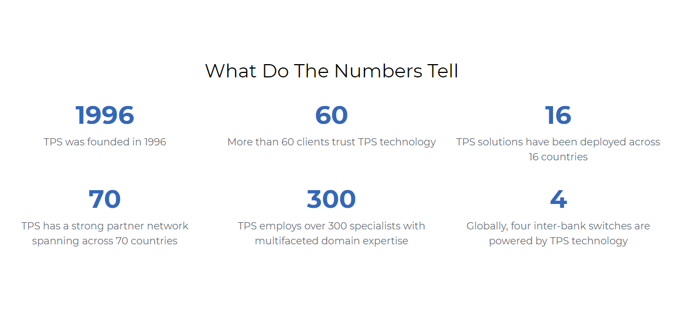
About TPS
P@SHA ICT Awards
Best Application Award for APICTA
Brands of the year Award
1Link Partner Success Award
PMI-KPC Awards
FPCCI Achievement Awards
Notes:
So Let me give you a short introduction about TPS?
TPS was Founded in 1996…. and currently it is a leading and trusted payment solution provider for more than 20 years.
We provides cards and payment solutions for
Various commercial and central banks, telecoms and financial institutions.
Our customer base spans across the
Middle East, South Asia, Africa and Europe.
We have more than 60 Clients using payment solutions of TPS Across 16 countries
We also have a strong partnership model with our network spanning across 70 countries
These are the list of awards and recognitions
Let me show you some solutions and services of TPS

Slide 7
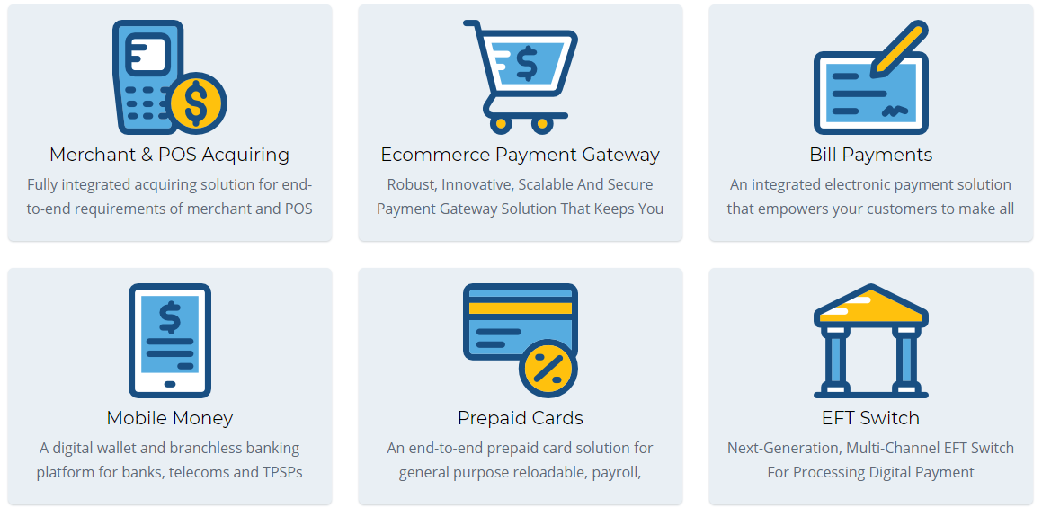
TPS Solutions and Services
Notes:
Here they are, we provide Payment card solutions for Merchant & POS, Bill Payments , ATM, Mobile Money, Prepaid Cards and Switch
TPS has More than 80% market share in Pakistan and you can’t perform any e-banking transactions without going through one of TPS product
If we see Globally, there are 4 inter-bank switches that is the backbone of transactions are powered by TPS technology

Slide 8
Code Management Before CICD
Senior Management
Project Team 1
Project Team 2
Project Team 3
Customer 1
Customer 2
Customer 3
Code Base 1
Code Base 2
Code Base 3
Feature 1
Feature 2
Feature 3
Notes:
in this slide we are trying to describe that what was the old code management structure before the implementation of CICD
So We had Separate teams for each client with their own code base and features, for example if had 3 project of banks A, bank B and bank C
then we had 3 separate code bases the major problem area were there was No Code Centralization there was No bifurcation between standardized and customized features Which means We had a complete Projectized team structure
We had completely Manual Build Creation , Manual testing and manual Deployment as well

Slide 9
Thought Process for CICD Adoption
It should not change because
We work this way and achieved a lot with this model
It is not for Financial Applications
We don’t have skillset
Transition is too costly
Our customers are neither demanding nor progressive enough
It must change because
It works but it’s not sustainable and scalable
Our customers are not happy with cost and duration of projects
Any agile startup can disrupt us being more efficient
When Continuous Delivery becomes a norm, our customers will demand it and we cannot do it overnight
Notes:
So as soon as there was a realization of these gaps in the process, a recommendation was made few years back to launch a new version of the product with a new process and team structure which can enable automated delivery pipeline. But , there were two clear schools of thought appeared as a response. Those who were more into the day to day operations and working on them for several years showed some reluctance and came up with some interesting arguments. As you can see some of them in the slide as well They thought that
we shouldn’t change a winning strategy why! because they were not sure about CICD practices for Fintech, they were unsure about whether we have the required skillset
and the cost of transition.
And most importantly, they thought why should we adopt something our clients are not demanding.
But still, the decision was taken to implement CICD as management took all the above arguments as either inertia of the legacy system or the risks to be mitigated.
If we had to sustain, we had to move on and be competitive enough. It’s not necessary that what had worked in the past would continue to work forever.

Slide 10
Risks Mitigation
Risks | Mitigation
We work this way and achieved a lot with this model | Identify and highlight opportunities
CICD is not for Financial Applications | Incremental Approach - Pilot Projects - Built-in security in delivery pipeline
We don’t have skillset | Create a dedicated team for CICD and train them
Transition is too costly | Cost-Benefit and ROI Analysis
Our customers are neither demanding nor progressive enough | Take customers onboard and start awareness programs
Notes:
So the senior and middle management got their acts together and draw a transformation strategy addressing concerns of the old folks.
A mitigation was planned for each of the major risk identified that included raising awareness in-house and among the clients about the benefits and requirements of CICD. It was also decided that an intelligent and incremental approach would be taken after cost-benefit analysis.
As you can see there are some major RISKS with their mitigation on this slide what one could face while implementing CICD for FinTech

Slide 11





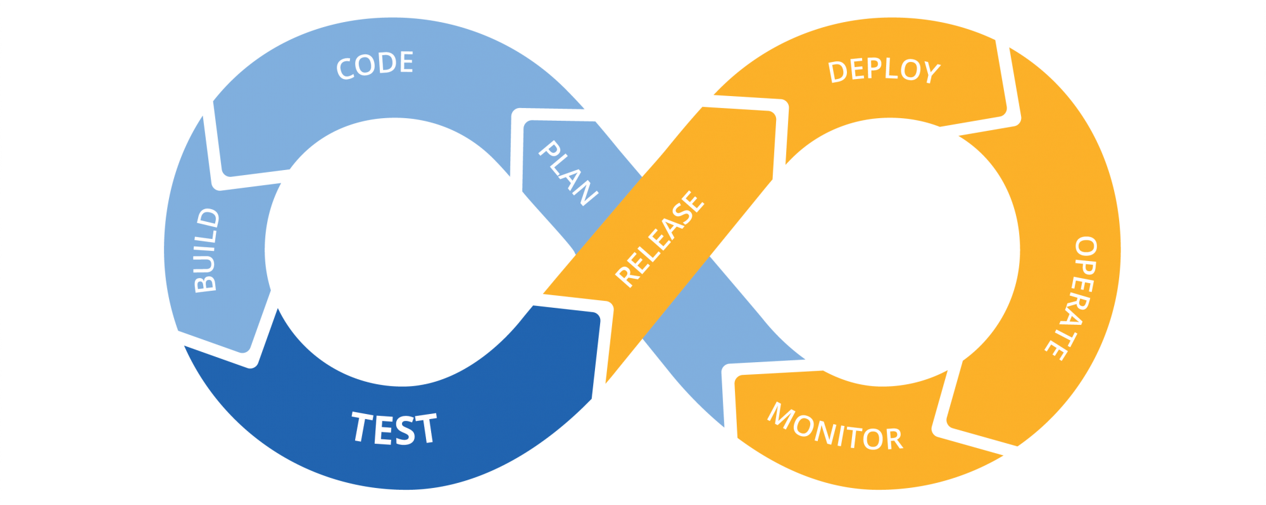


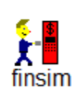
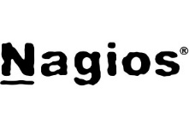


Major Tools in Use
TFS
Notes:
Many of you have already seen this type of picture, displaying the complete CICD cycle of an organization,
What we have done here we have added the tools that we are using with each and every step from Planning to Deploy and Monitor
You have seen many material on GIT and Xamarin, TFS this is what we are also using We have created CI builds in TFS they use to compile code on the build server with every check-in and you can also schedule or use them on need basis
SO What’s new in Fintech then?
To cover this question and
The Most Important part I like to cover is CONTINUOUS TESTING if you are testing the financial payments solutions the first thing you need is
Channel simulator which covers all scenarios that can appear on real channels for example you can’t buy physical ATMS of all vendors to test your payment solution on it , and your can’t create all type of physical cards like VISA, Master Card, Amex JCB etc.. For this the best available solution is tools like FINSIM, BPSIM etc
We have used all of the above tools for the implementations of CICD for multiple payment solution projects, but we are not saying that these are not the only recommended tools or the best tools.
You can use these tools or any other tools that best fits with your application framework
Now I would like to ask Umair, to explain the code structure after cicd… Umair

Slide 12
Code Management After CICD
Senior Management
Product Factory
DevOps
Project Delivery
CICD
Feature 1
Feature 2
Feature 3
Feature 4
Customer 1
Customer 2
Customer 3
Customer 4
Product Code
Automated Delivery Pipeline
Customization Layer 1
Customization Layer 2
Customization Layer 3
Customization Layer 4
Notes:
If you remember we talked about the major problem of pre-CICD process was how the code was being managed. So, a new process had to get rid of this problem by centralizing the code management.
It was observed that most of the features are common to all the clients which are mostly the banks. The common features should be integrated as standardized product along with configurability and auto-deployment capability. Still, we could not rule out the unique requirements of the
clients which should be handled in a customization layer that is written on top of the base product.
But the real differentiating factor has been setting up a dedicated DevOps unit one of whose function is to implement a CICD cycle which automatically compiles the product and customization code deploy the application, configure it, execute automated tests on the deployed application and notifies the stakeholders about its readiness for auto deployment on production.

Slide 13
Release Cycle
Commit
Automated Tests
Merge to Master
Automated Tests
Automated Performance Tests
Automated Security Tests
Create Release Branch
Setup Creation for Fresh Installation
Automated Deployment to QA Machine
Automated Deployment to QA Machine
Deployment to Staging Environment through Setup
Automated Smoke Test and Demonstration
Setup Execution and Product Configuration on SIT Environment
Automated + Manual Testing on SIT Environment
Setup Execution and Product Configuration on UAT Environment
Automated + Manual Testing on UAT Environment
Setup Execution and Product Configuration on Production
Monitoring on Production
Static Code Review
Notes:
Now this is the slide you must be most interested in. It shows how this complete automated delivery cycle works in a complicated, huge and sensitive ecosystem like Financial technology. We have a monthly release cycle where we release a new version for all the existing and the new clients containing all the changes we planned at start of the month. Although it’s a long cycle, but you’ll get the ppt on request. So you don’t have to go through the entire flow. The summary for you is there are Git branches involved and there are QA, staging, SIT, UAT and production environment. So, the automated delivery pipeline with some changes is repeated on all these combinations with minimum manual intervention. Some of the steps like static code review, performance and security tests are performed before the release but not repeated on later environments unless there’s a specific need. The ultimate objective is to have this cycle completely continuous without any manual intervention but the items you see in yellow are the ones where manual supervision and decision making is involved. But the reasons for that is also not too technical rather they’re based on the process, culture, ownership and the team structure we have right now which also have to be taken to another level in order to take any code commit to production on continuous basis.

Slide 14
Patches for Bugs Fixing
Commit
Automated Tests
Automated Tests
Merge to Master
Repeat Release Cycle
Automated Deployment to QA Machine
Automated Deployment to QA Machine
Create tag in Release Branch
Email to cicd@tpsonline.com
Automated Patch Creation and Alert
Patch Execution on SIT Environment
Automated + Manual Testing on SIT Environment
Patch Execution on UAT Environment
Automated + Manual Testing on UAT Environment
Patch Execution on Production
Monitoring on Production
Notes:
When we talk about the monthly release cycle, the first question that comes to our mind is how can you make the customers wait for a month in case of fixes required on production. So, as you can see we have expedited cycle for releasing patches. Just as QA is done verifying the fix, it creates a tag in the release branch and shoots an email to a specific email address which triggers an automated process for patch creation with differential files and scripts packaging. As soon as the patch is created, an alert is sent to all the recipients of the original email about location of the patch. And support team takes it to production as required by the client. This whole process doesn’t require any manual intervention either it’s a day time or a midnight. This has been working very smoothly for more than a year now with excellent response time of 30 minutes after tag creation. The only thing that needs to be improved is the execution of patches is still the decision to be taken manually and not all the patches go to all the clients simultaneously. They are executed on production with some time lag and only the customer who has reported the bug is provided the patch on priority. There are obvious reasons for this and we also have alternative solutions for releasing the consolidated patches for other clients but ideally all the patches should be executed on all the clients immediately without manual intervention.

Slide 15
Impact
Faster Time to Market
Increased Productivity
Improved Quality
Flexibility and Responsiveness
Better Maintainability
Reduced Human Dependency
Reduced Downtime
Notes:
Now since we have seen most of the aspects of how we are executing CICD cycle at TPS, let’s take a look at what impact we have observed after adoption so far. We now have much faster time to market. In our pre-CICD process, we were not able to push changes to all our clients with a monthly frequency. But it looks very much possible now. Productivity has been observed as increased. We’re facing lesser issues now since CICD cycle has matured. Our response time in terms of fixes has improved as we talked about earlier. It’s now easier to assure there’s no regression issues specially having a financial impact whenever we push changes to production. Human dependency is getting reduced which implies that there are less human errors involved, cost saved and people can spend their time in more creative tasks rather than mundane tasks. Most importantly, those of you who know financial industry well, any down time is hazard for the business. Through CICD, we are continuously reducing the production downtime during deployments.

Slide 16
Challenges at Hand
Behavioral Changes and Technology adoption
Trade-off between reliability and speed
Slow decision making
Compatibility between automated and manual solutions
Dependency on CICD Engineers
Subjective benefits overlooked
Expectation of zero downtime
Notes:
Having acknowledged that there’s a significant success so far in the implementation and adoption of CICD, we also have to realize the challenges we’re still facing for implementing CICD in a true spirit. The foremost is implementation and adoption are going at quite a different pace. We develop and enhance a lot of solutions that require behavioral changes for adoption and so it takes time. Secondly, throughout the journey we have observed that as soon as we try to go too fast we face reliability issues and so being in Fintech, you can’t compromise on reliability. So you appear slower than other technology companies with regards to CICD. Another important problem is there are still some manual solutions in various phases such as few manual tests and release readiness checks. Then we face challenges while our implementation engineers are not properly trained or have a skillset to use the automated deployment and testing solutions. So they become dependent on a small team of CICD engineers which look overburdened sometimes. Lastly, we talked about the improving downtime with CICD cycle but the actual expectation from the customers is zero downtime which is our next target and look very much possible now in near future.

Slide 17
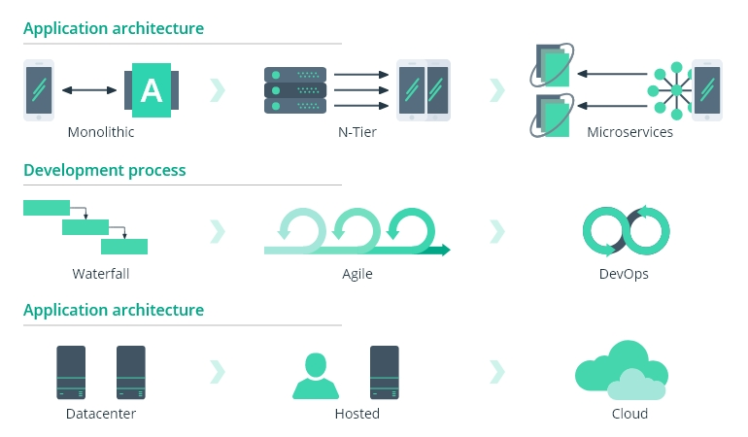
High Level Gaps
Notes:
This is another view of the gaps identified so far in enabling true automated delivery pipeline. First of them is it’s an enterprise level application with a monolithic architecture where many of the automated solutions become less effective unless you move towards microservices architecture. Secondly, we have attained certain maturity in terms of Agile but it’s about time some decisions are taken to transform it into DevOps. And for that, we need to host application on clouds primarily which has already been initiated but it’s in a very initial stage right now to be visibly effective.

Slide 18
Roadmap
Completely Automated SIT and UAT
Adopting Latest Deployment Solutions
Embedding Non-Functional Testing in Delivery Pipeline
Improving Release Management Process
Continuous Compliance
Strengthening Quality Gates
Notes:
What we have planned strategically is to have all the testing automated in all the environments as much as possible. Then we’re still using Wix based setups with little flexibility and usability options. Then performance and security testing is sometimes compromised which needs to be looked at. Release management process has to be fully automated including the decision making. The compliance of standards such as PADSS and ISO 90027 have to be made part of the continuous process and most importantly quality gates should be strengthened as quality assurance is right now the biggest bottleneck in the continuity of this cycle

Slide 19
Dream Or Reality?
Customer Satisfaction?
Notes:
Before we conclude, we need to answer the basic question we started with. My take on this is : what we have shown in terms of CICD implementation and adoption in the last few minutes is purely a reality which used to be dream few years ago and we shouldn’t be in any doubt about its possibility or applicability in Fintech. However, the dream is still not over yet as certain enabling factors have yet to play their role in their full capacity. When we looked at the impact and positive changes CICD has brought in one of the leading fintech organizations, it was missing an important factor and that is customer satisfaction. While all the positive changes have a direct impact on customer satisfaction, we still need a better evidence to prove that CICD has actually resulted in increased customer satisfaction. So, if CICD in fintech has to be truly a dream come true, it has to be complimented by an enabling environment and the supporting factors such as management and customers onboarding. And most importantly, “CICD for Fintech” has to be taken as a different ambition than CICD in any other industry.

Slide 20
Key Takeaways
Have Patience
Don’t reinvent
Comply to Financial Industry Standards
Realize Unique Needs of Financial Industry
Management onboarding is critical
Convince and enlighten the clients
Don’t be dependent on specific tool
Notes:
•It will take time to implement real CICD practices in Fintech
•Focus on small improvement for long term benefits
•Don’t go for automation of everything, use 80-20 rule and focus on the automation of pain areas initially
•Don’t reinvent the wheel, Use already developed Fintech Simulators and Automation Tools
•Fintech has its own secure development standards like PADSS, Which means you have to fit your process as per Fintech standards
•Fintech Challenges are unique, you can’t relate other software industry models on it
•To Implement CICD you have to change the culture of industry so make sure that the Higher Management is with you
•Do not focus on one tool or some specific programing language

Slide 21
Questions
Comments
Suggestions
umair.khalid@tpsonline.com
ali.jaffer@tpsonline.com
umair.khalid@tpsonline.com
ali.jaffer@tpsonline.com
Notes:
So that’s all from our side. I would like to thank you all for bearing with us and I would love to hear from you if you want to know more details or clarify any ambiguity as this was a complex topic which we have tried to cover on a higher level.

